Slide 1
Interview Android App
Guide : Mr M.Raaja
A Jaya Pavan Kumar(9915004227)
A Sreekanth Reddy(9915004098)
D Sai Pavan(9915004144)

Slide 2
Abstract
The purpose of our Interview Android app mainly focus on the final year students of engineering .The Students can upload the resume in the app and we will provide the notifications regarding to the student . He can also search for the job in their nearer locations by our app .
Our application is content-oriented which helps the student to prepare for aptitude to clear the first round of any company .Here the student can test knowledge by writing the quiz.

Slide 3
Objectives
The app will helps the students to learn the aptitude for their first round during the interview ,it also provide tips and smart tricks to clear the aptitude round
The main feature of our app will helps the students to find the interviews nearer to their locations , and also get notifications regarding to their streams.
Our app helps the students to prepare company wise regarding

Slide 4
Review Of Literature Survey
Once upon a time getting a job is quite easy because of less competition . Now in a revolutionized world getting a job is very difficult ,students are facing many difficulties to crack the interview due to lack of aptitude and verbal knowledge .
According to our literature survey students don’t know how to prepare for aptitude and other competitive examinations . This app allows each and every student how to prepare and crack the competitive examinations in an easy way.

Slide 5
Authors | Lu Shumin Xi'an JiaoTong University, School of Economics & Finance, China Rao Yuan Xi'an JiaoTong University, Shool of Software Engineering, China
Date Of Conferene: | 4-6 Dec. 2010
ISBN No: | 10.1109/ICISE.2010.5690003
Journal: | The 2nd International Conference on Information Science and Engineering

Slide 6
Abstract | Now, the employment for college graduates is becoming a focus-point problem for the society and livelihood in China. With the rapid development of information technology and electronic commerce applications, more and more people realized that only to promote the symmetries and transparency about information can provide more equal opportunities for various graduates. In order to solve the deficiency about existed employment management system, a core business scenario is proposed in the paper for the whole process of employment, which includes five roles, such as government, enterprise, university, student, and platform administrator. Based on analyzing the five meta-models for employment in dynamic e-Commerce, i.e., B2C for student, B2B for enterprise and university, C2C for personal society network, mobile Commerce and collaborative e-Commerce for employment application, a new dynamic e-Commerce model, enterprise-University- Student Trading Model (DEC-EUST) about recruitment for college graduates is proposed in the paper. Furthermore, an independent management platform for Campus Recruitment, XiaoZhen website, is designed, which integrates the five meta-model for employment channel and provides comprehensive information services for every platform role.

Slide 7
Novelty of the proposed system
Previously we don’t have any apps combined with all modules such as preparing for the aptitude ,preparing for the technical HR ,general HR and company wise .And also uploading resume and getting notifications regarding to the resume ,searching for a job in recent locations . Here we proposed the new existing real time application called interview android app with all these features and benefits

Slide 8
STUDY ON TOOLS
Android Studio:
Android studio is the official integrated development environment for google ’s Android operating system , built on JetBrains ‘IntelliJ IDEA software and designed specifically for android development.
Firebase:
The Assistant tool window in android studio .Firebase is a mobile platform that helps you quickly develop high quality apps ,grow your user base and integrate firebase services in your app directly from android studio using the Assistant window

Slide 9
Module/Algorithm justification
Log In Module
Resume Upload Module
Job Search Module
Job Notifications Module
Aptitude Preparation Module

Slide 10
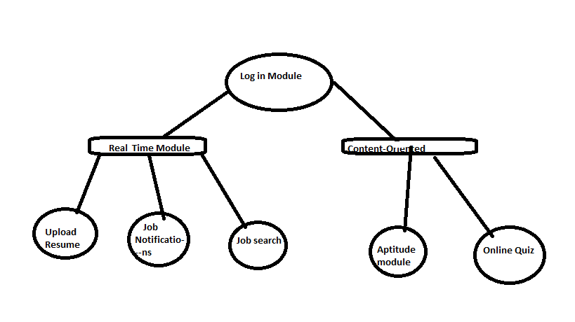

Slide 11
Log In & Register Module is used to log in to the app and register for new User
Resume upload is used to help the user to upload the resume
Job Notification Module helps the user to receive the job offers available to him
Search for a job helps the student search for a job in nearer locations
Aptitude Module helps the student for preparing logical , quants ,verbal for cracking the first round
Quiz Module helps the student to improving their knowledge

Slide 12
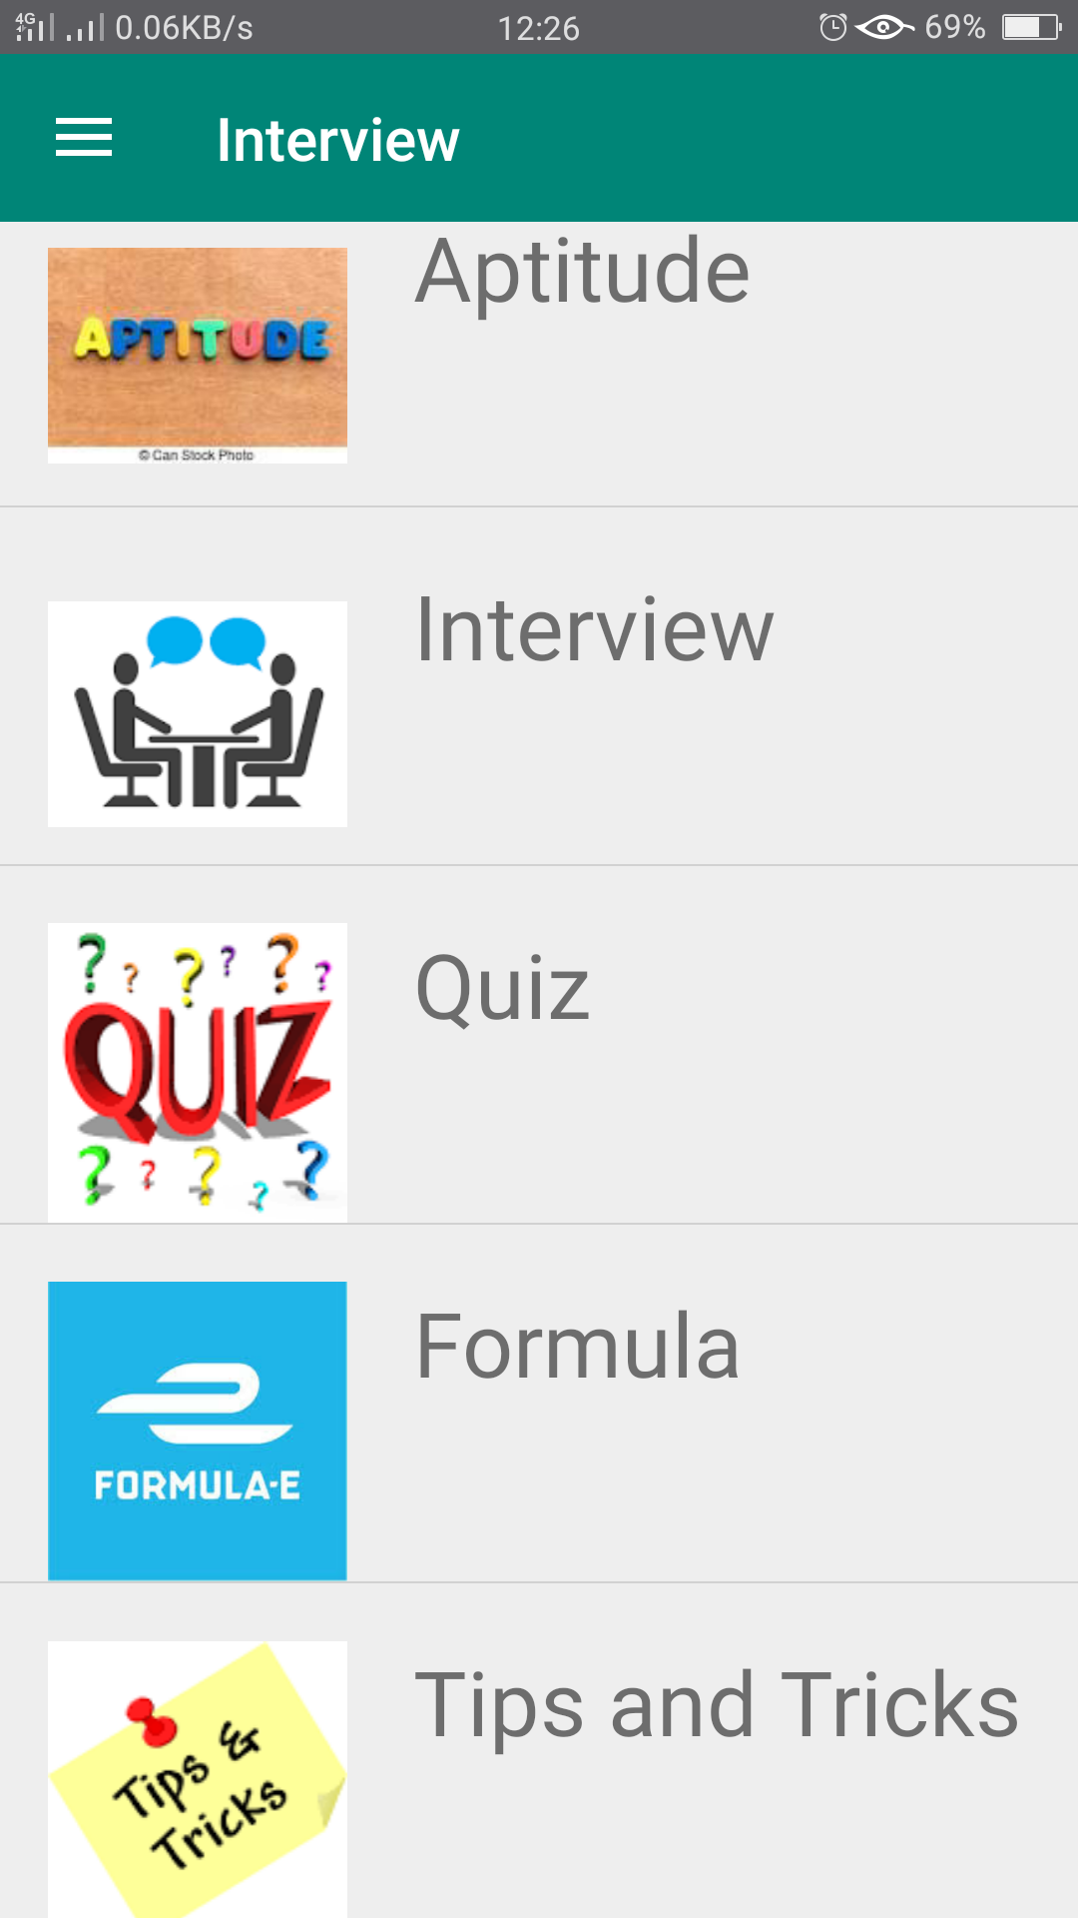
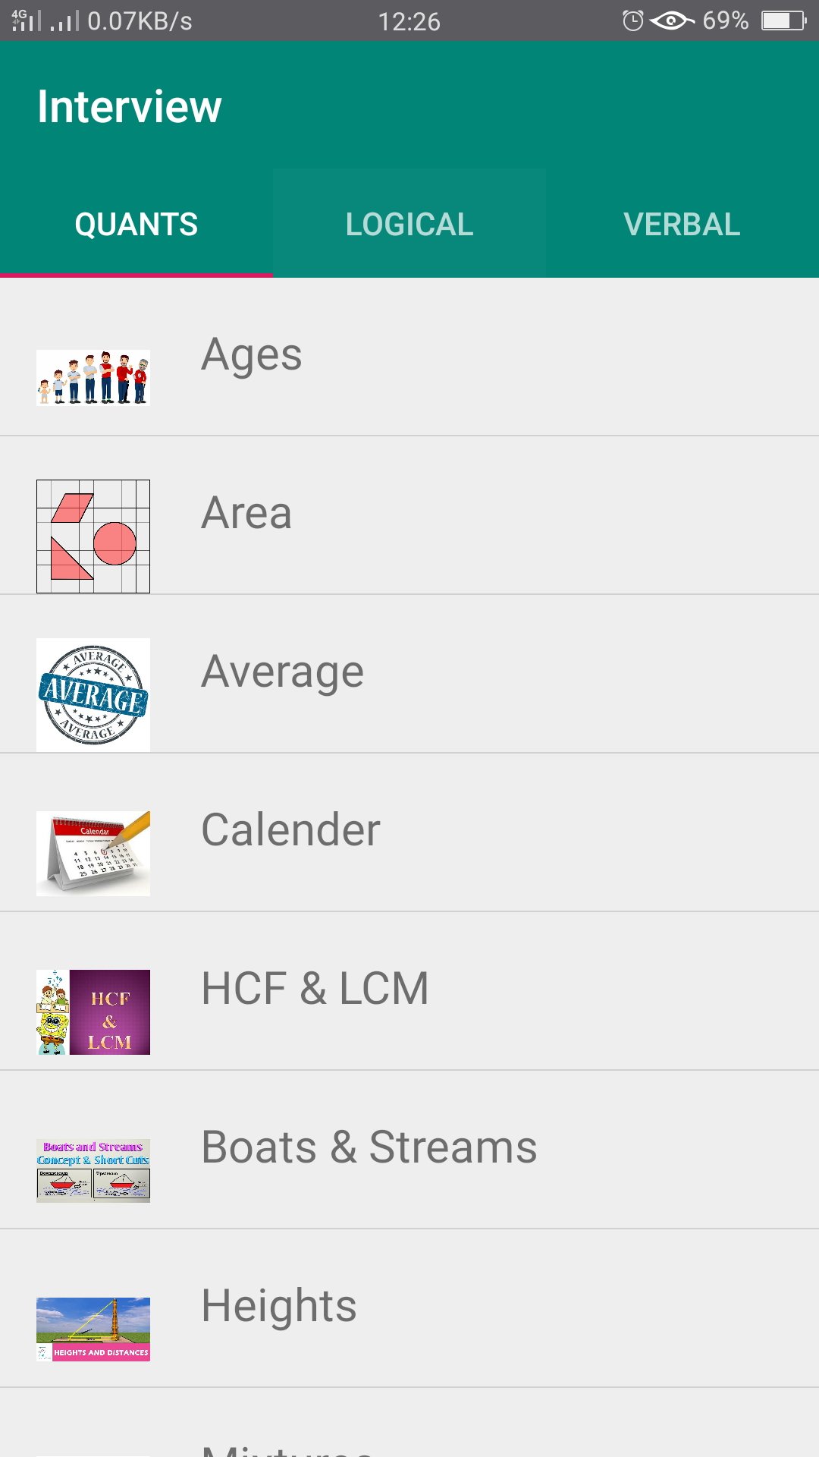
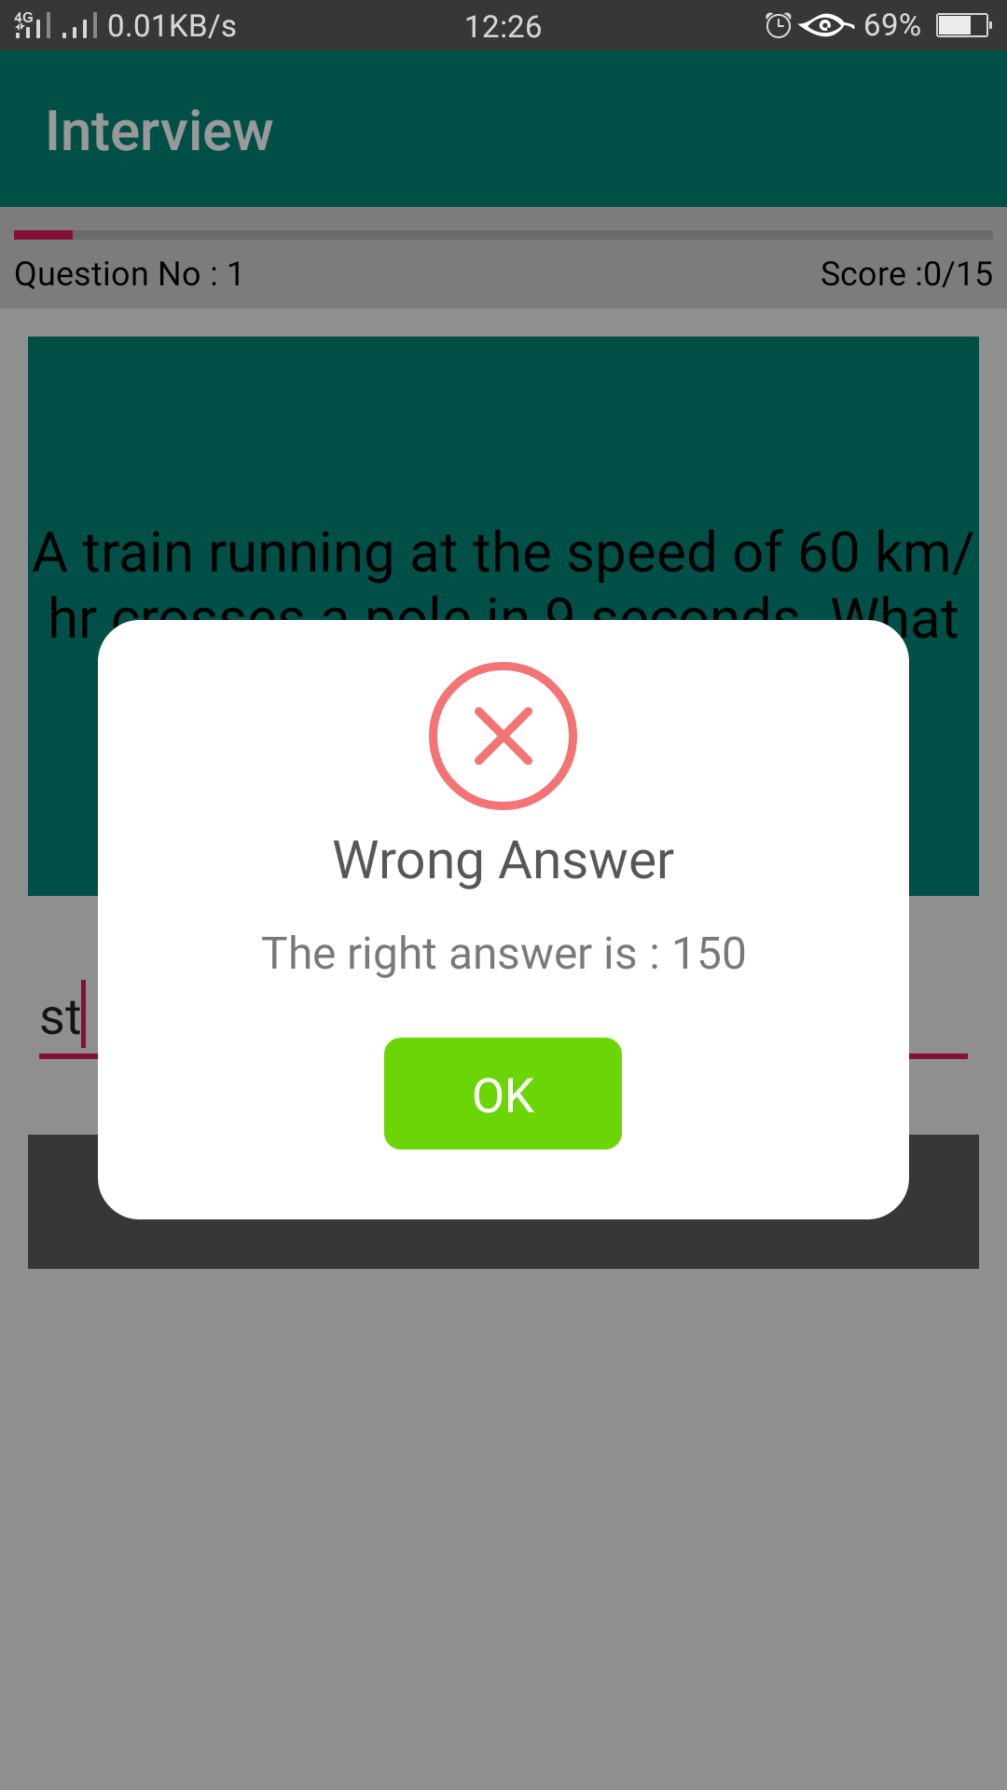
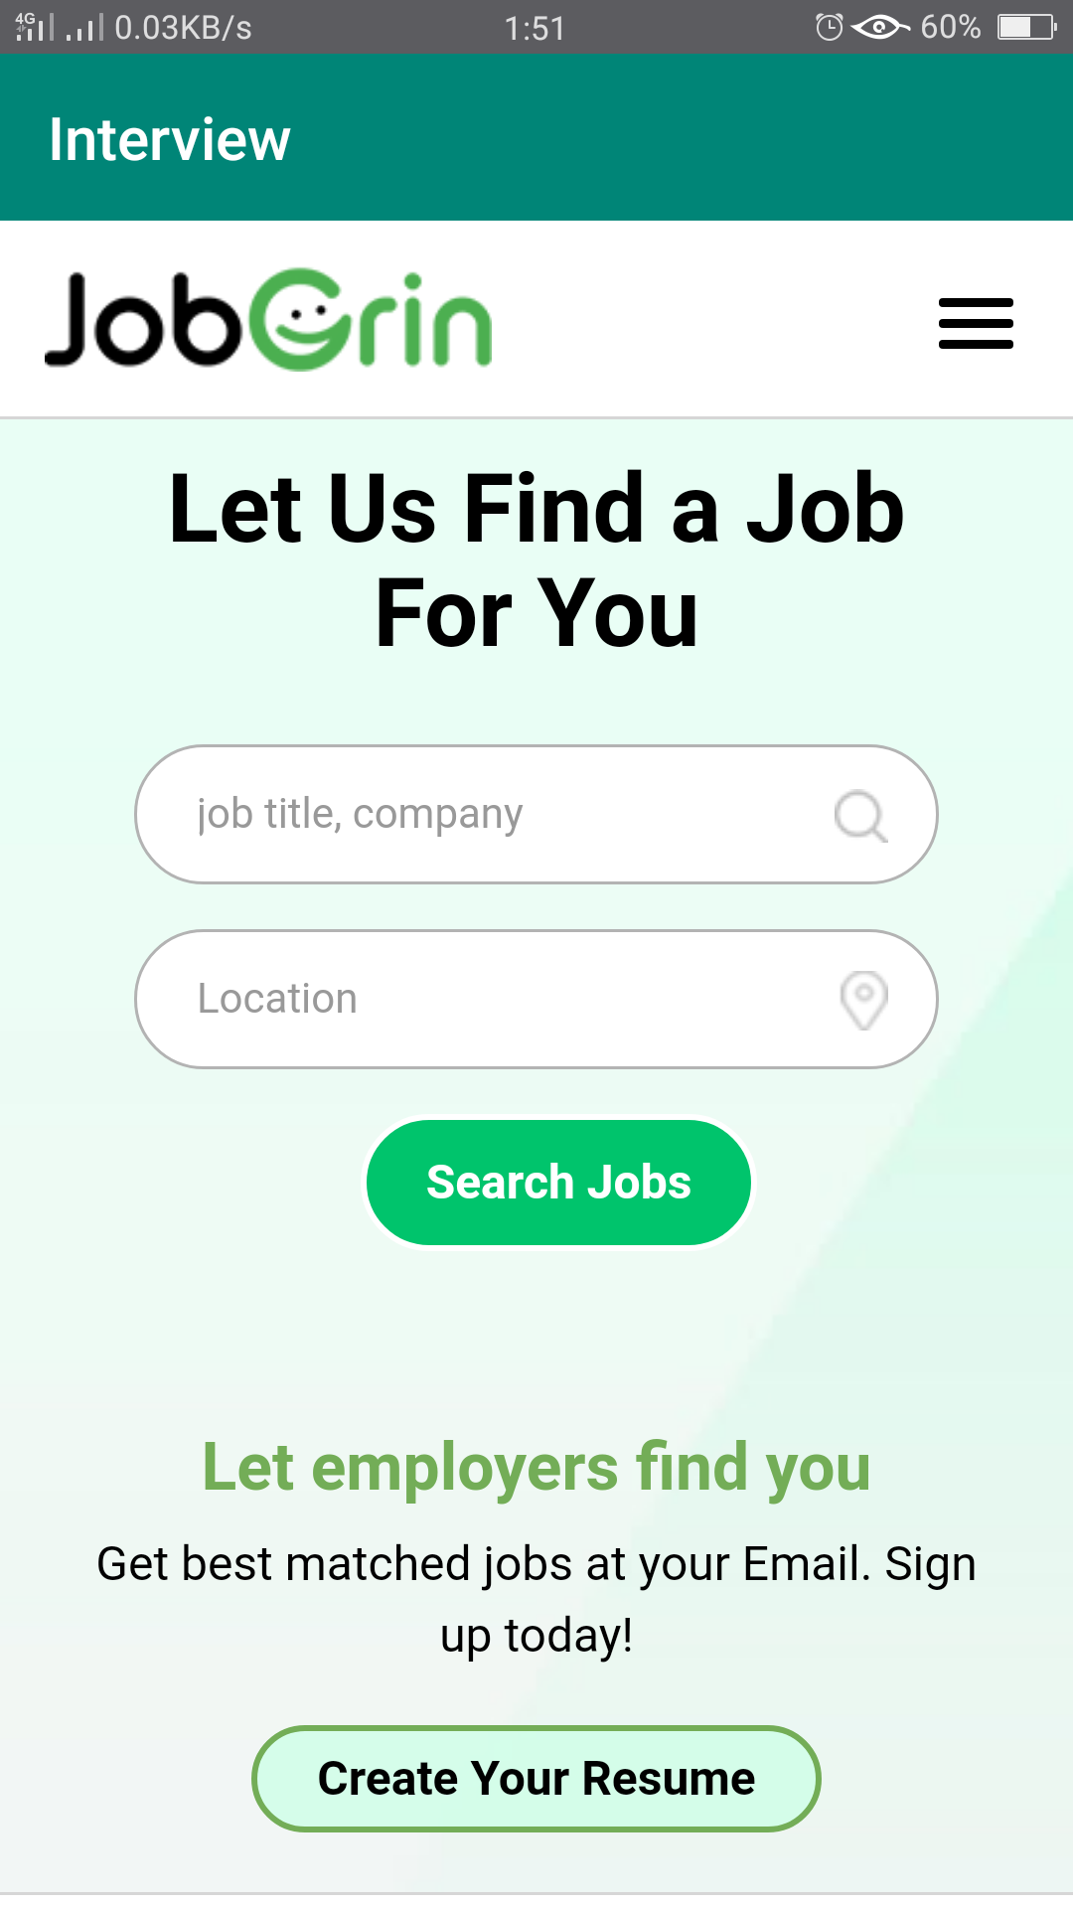
Output and Screenshots

Slide 13
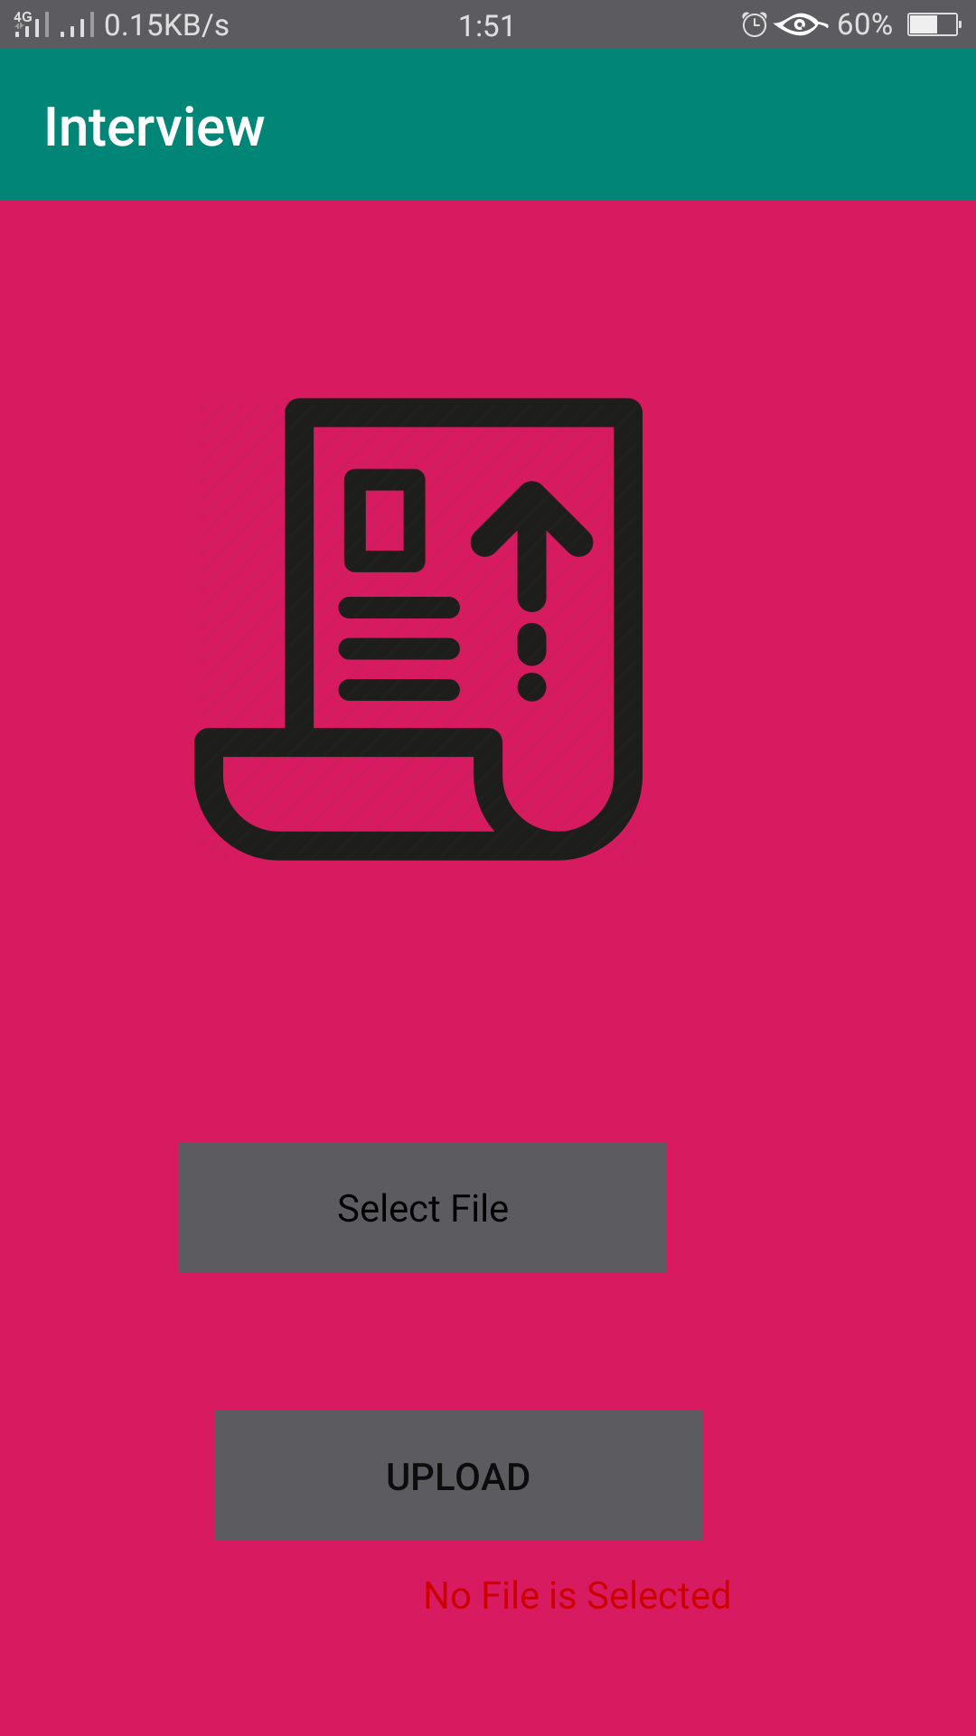
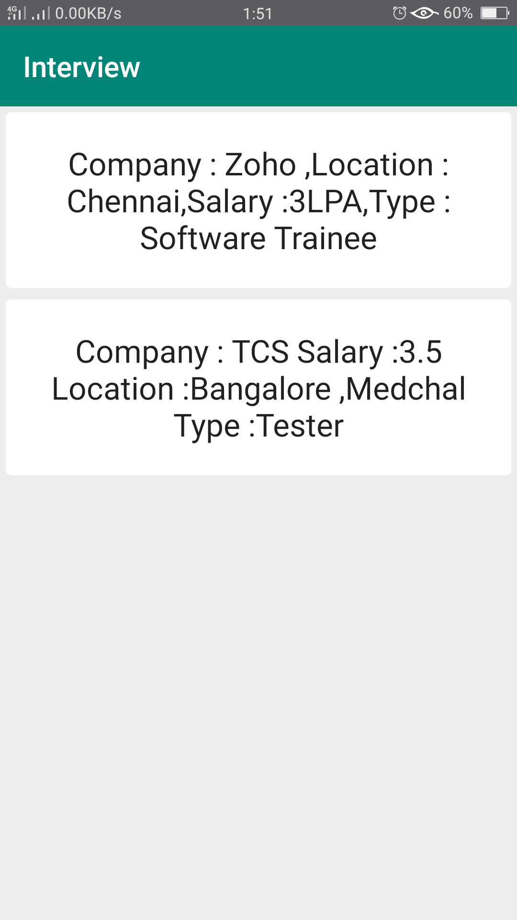

Slide 14
References
An already existing app called “solo learn” where we find popular languages tutorials
https://play.google.com/store/apps/details?id=com.sololearn&hl=en
AndroidDevelopers.com
https://developer.android.com/index.html
Android-arsenal.com
https://android-arsenal.com/

